Slide 1
File operation

Slide 2
How to VB.NET FileStream operations
The FileStream Class represents a File in the Computer.FileStream allows to move data to and from the stream as arrays of bytes. We operate File using FileMode in FileStream Class
Some of FileModes as Follows :
FileMode.Append : Open and append to a file , if the file does not exist , it create a new file
FileMode.Create : Create a new file , if the file exist it will append to it
FileMode.CreateNew : Create a new File , if the file exist , it throws exception
FileMode.Open : Open an existing file
How to create a file using VB.NET FileStream ?
The following example shows , how to write in a file using FileStream.

Slide 3
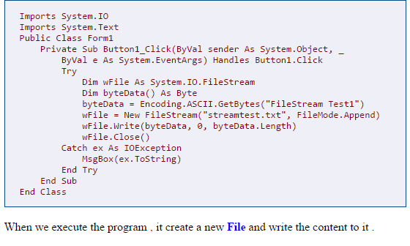

Slide 4
How to VB.NET TextReader operations
Textreader and TextWriter are the another way to read and write file respectively, even though these are not stream classes. TheStreamReader and StreamWriter classes are derived fromTextReader and TextWriter classes respectively.

Slide 5
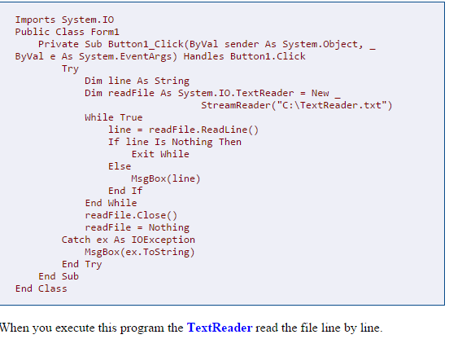

Slide 6
How to VB.NET Simple TextReader
Textreader and TextWriter are the another way to read and write file respectively, even though these are not stream classes. TheStreamReader and StreamWriter classes are derived fromTextReader and TextWriter classes respectively. The following program using TextReader , Read the entire content of the file into a String

Slide 7
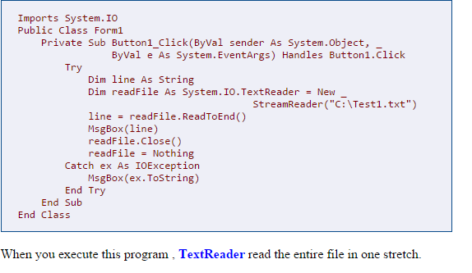

Slide 8
How to VB.NET TextWriter
Textreader and TextWriter are the another way to read and write file respectively, even though these are not stream classes. TheStreamReader and StreamWriter classes are derived fromTextReader and TextWriter classes respectively. The following sample source showing how write in a file using TextWriter .

Slide 9
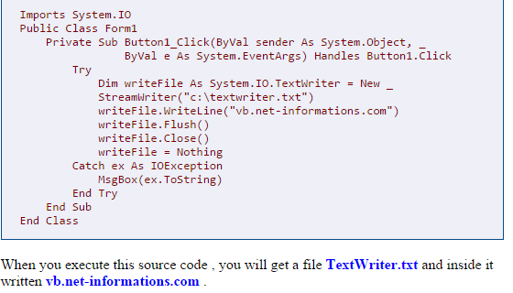

Slide 10
How to VB.NET BinaryReader
BinaryReader Object works at lower level of Streams.BinaryReader is used for read premitive types as binary values in a specific encoding stream. Binaryreader Object works with Stream Objects that provide access to the underlying bytes. For creating a BinaryReader Object , you have to first create a FileStream Object and then pass BinaryReader to the constructor method .
Dim readStream As FileStream
readStream = New FileStream("c:\testBinary.dat", FileMode.Open)
Dim readBinary As New BinaryReader(readStream)
The main advantages of Binary information is that stores files as Binary format is the best practice of space utilization.

Slide 11
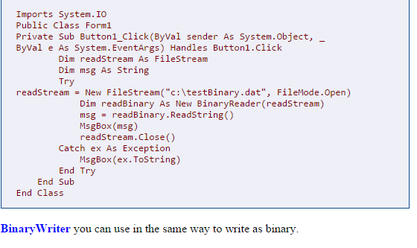

Slide 12
How to VB.NET BinaryWriter
The BinaryWriter Object works at lower level of Streams.BinaryWriter is used for write premitive types as binary values in a specific encoding stream. BinaryWriter Object works with Stream Objects that provide access to the underlying bytes. For creating a BinaryWriter Object , you have to first create a FileStream Object and then pass BinaryWriter to the constructor method .
Dim writeStream As FileStream
writeStream = New FileStream("c:\testBinary.dat", FileMode.Create)
Dim writeBinay As New BinaryWriter(writeStream)
The main advantages of Binary information is that it is not easily human readable and stores files as Binary format is the best practice of space utilization.

Slide 13
